Slide 1
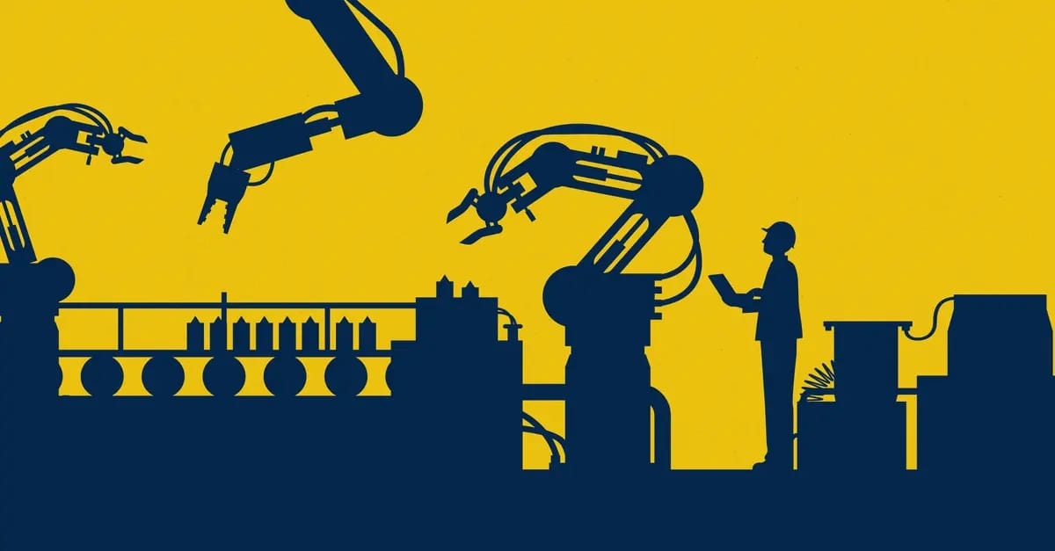
INDUSTRY 4.0
The Fourth Industrial Revolution — Smart, Connected & Autonomous Manufacturing
Presented by:
Surya (261096)
Vicky (261095)
Saket (261087)
Aryan (261085)
Branch / Section: Computer Science & Engineering | Section B
IN THE GUIDANCE OF SHIVANI MAM

Slide 2


INTRODUCTION
WHAT IS IT?
Industry 4.0 is the ongoing fusion of physical production with digital intelligence — connecting machines, sensors, and systems so factories can sense, analyse, and decide in real time.
WHY IT MATTERS
01
Faster, data-driven decisions
Real-time sensor data replaces guesswork on the shop floor.
02
Higher productivity & uptime
Predictive maintenance cuts unplanned downtime sharply.
03
Mass customisation at scale
Smart systems make small, flexible batch runs cost-effective.
INTRODUCTION
02

Slide 3

BASIC CONCEPT
DEFINITION
Industry 4.0 is the integration of Cyber-Physical Systems (CPS), the Internet of Things (IoT), Cloud Computing and Artificial Intelligence into manufacturing, creating “smart factories” that are self-monitoring and self-optimising.
IN SIMPLE WORDS
Think of a traditional factory getting a nervous system: sensors are the nerves, software is the brain, and the internet is what lets every machine “talk” to every other machine — and to people — instantly.
KEY TERMS
Cyber-Physical Systems
Internet of Things (IoT)
Big Data & Analytics
Industry 1.0 (steam) → 2.0 (electricity) → 3.0 (computers) → 4.0 (connectivity + AI)
Smart / Digital Factory
BASIC CONCEPT
03

Slide 4





KEY FEATURES
The building blocks that make a factory “smart”
Interconnectivity
Cyber-Physical Systems
Cloud & Big Data
Machines, sensors and systems share data continuously across the shop floor.
Physical equipment is mirrored and controlled by embedded software.
Massive data streams are stored, processed and analysed off-site in real time.
AI-Driven Decisions
Automation & Robotics
Cybersecurity
Machine learning spots patterns humans would miss and predicts outcomes.
Repetitive and precision tasks are handled with minimal human input.
Connected systems are protected end-to-end against digital threats.
MAIN CONTENT
04

Slide 5





SYSTEM ARCHITECTURE
How the core technology pillars connect around the smart factory
Cyber-Physical
Systems
INDUSTRY
4.0
Cyber-
security
IoT
Sensors
Robotics &
Automation
Cloud
Computing
Big Data
Analytics
Sensors capture live data → cloud stores & processes it → analytics and AI generate insight → robotics/CPS act on it — all protected by cybersecurity.
SYSTEM ARCHITECTURE
05

Slide 6




REAL-WORLD APPLICATIONS
Automotive
Healthcare
Agriculture
Logistics
Connected assembly lines and predictive maintenance keep production moving with minimal downtime.
Smart devices and real-time monitoring support faster diagnosis and remote patient care.
IoT sensors track soil, weather and crop health to guide precision farming decisions.
Automated warehouses and smart tracking optimise inventory and delivery routes.
APPLICATIONS
06

Slide 7



ADVANTAGES & LIMITATIONS
ADVANTAGES
LIMITATIONS
Higher productivity through automation and optimisation
High initial investment in equipment & infrastructure
Predictive maintenance reduces costly downtime
Cybersecurity risk grows with connectivity
Better quality control via real-time monitoring
Requires reskilling of the existing workforce
Flexible, cost-effective mass customisation
Careful planning turns most limitations into short-term costs, not long-term blockers.
ADVANTAGES & LIMITATIONS
07

Slide 8
CONCLUSION
“Industry 4.0 is not a single technology — it is the connection of many, turning data into decisions and factories into intelligent systems.”
1
It combines IoT, AI, Cloud Computing, Big Data and Robotics into one connected ecosystem.
2
It shifts manufacturing from reactive to predictive, and from rigid to flexible.
3
Adoption brings real productivity gains — but also real costs, risks and reskilling needs.
4
Industry 4.0 is already reshaping manufacturing, healthcare, agriculture and logistics worldwide.
CONCLUSION
08

Slide 9
REFERENCES
BOOKS
Schwab, K. — The Fourth Industrial Revolution. World Economic Forum, 2016.
Kagermann, H. et al. — Recommendations for Implementing Industrie 4.0. acatech, 2013.
WEBSITES
www.weforum.org — World Economic Forum, Industry 4.0 topic hub
www.plattform-i40.de — Plattform Industrie 4.0 (Germany)
www.mckinsey.com — McKinsey Digital, manufacturing insights
ARTICLES / VIDEOS
IEEE Spectrum — articles on Cyber-Physical Systems and Smart Manufacturing
Siemens & Bosch official channels — Industry 4.0 case-study videos
REFERENCES
09

Slide 10

THANK YOU
Any Questions?

